Slide 1
CODING AND DECODING
P. Vijay Kumar
Aptitude Trainer
Department of Training & Placement
Aditya University

Slide 2
Introduction
Coding and Decoding
The coding questions will provide you with some information that is in code form. This information can be decoded using the key that is present either within the question or within the options.
Letter Coding
This is the code that is derived on the basis of alphabets. usually, the position of alphabets is used.

Slide 3
Concept and Definitions
Number Coding
In this if letters of words are coded in number, then we have to decode it in particular letters and vice-versa.
Symbol Coding
In the symbol coding, we use the symbols like “!@#$%^&*()_”, to represent words or letters. These codes are then used to determine a code for the words that are written

Slide 4
Questions
Ques 1. In a certain code language, 'MAZZA' is written as 'OBBAC' and 'BLACK' is written as 'DMCDM'. How will 'FUZZY' be written in that language?
a) HVBBA
b) HVBAA
c) HTBAA
d) HVBZA
Notes:
ADD +2,+1 for every letter
HVBAA is correct answer

Slide 5
Questions
Ques 2. In a certain code language, 'ALWAYS' is coded as 'AKYAXU'. What is the code for 'BEYOND' in that code language?
a) BDAOMG
b) BDAOME
c) BDAOMF
d) BDBOMF
Notes:
0,-1,+2, 0,-1,+2…
BEYOND → B D A O M G

Slide 6
Questions
Ques 3. In a certain code language, 'ANIMISM' is written as 'INAMMSI' and 'EAGERLY' is written as 'GAEEYLR'. How will 'FULFILL' be written in that language?
a) LUFLFLI
b) LUFFLLI
c) LUFFLIL
d) LUFFILL
Notes:
Divide them into equal parts leaving the middle letter as same and reverse them
A N I M I S M
I N A M M S I
F U L F I L L
L U F F L L I

Slide 7
Questions
Ques 4. In a certain code language, 'FELLOW' is written as 'NGHYQN' and 'PURPLE' is written as 'TWRGNR'. How will 'SUPRISED' be written in that language?
a) KUGFUWRT
b) TRWUFGUK
c) TRUWFGUK
d) UWRTKUGF

Slide 8
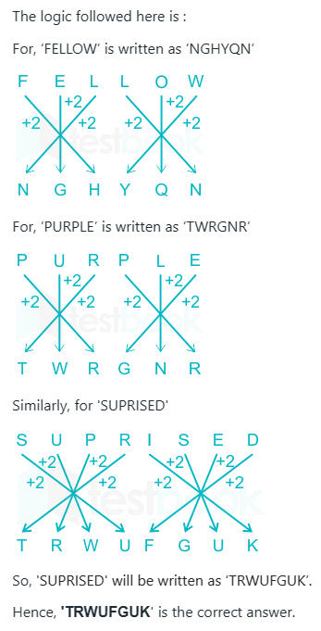
Questions

Slide 9
Questions
Ques 5. In a certain code language, "EASY" is written as "YAES", and "KIND" is written as "DIKN". How will "SOME" be written in that language?
a) ESOM
b) EOSM
c) EOMS
d) OESM
Notes:
Follow the order
1,2,3,4 Positions will interchange as 4,2,1,3
EOSM

Slide 10
Questions
Ques 6.In a certain code language, "CAUTIOUS" is written as "CUAITUOS", and "DEADLINE" is written as "DAELDNIE". How will "ECONOMIC" be written in that language?
a) ECOONIMC
b) EOCOINMC
c) EOOCNIMC
d) EOCONIMC
Notes:
Remain first and last letter constant, rest of them interchange as pairs
ECONOMIC
EOCONIMC

Slide 11
Questions
Ques 7. If in a code language, ORGANISATION is written as CBDWLQJWYQCL and OPERATION is written as CXFBWYQCL, then how is SEPARATION coded?
a)QCLYWBFXJE
b)JFQYWBCXQL
c)JFXWBWYQCL
d)EJXEBEYQCL
Notes:
Option:C
Get code of each letter from the given info.
ATION is common and the code is WYQCL
As SEPARATION also ending with ATION,code is JFXWBWYQCL.

Slide 12
Questions
Ques 8. Four letter – cluster pairs have been given, out of which there are alike in some manner and one is different. Select the one that is different.
a)SUYEMW : CAYWQI
b)QSWAGN : AWTXDH
c)CEIOWG : ASMKIG
d)DFJPXH : BTNLJH
Notes:
Answer : QSWAGN : AWTXDH

Slide 13
Questions
Ques 9. In a certain code language if the word 'CONCEPT' is coded as DQQGJVA, then how will you code the word 'EXECUTION' in that language?
(a) FZHFGZZPW (b) FZHGYZPWW
(c) FZHGZZPXW (d) FZHGZZPWW
Notes:
Option:4
Solution:
C O N C E P T
+1 +2 +3 +4 +5 +6 +7
D Q Q G J V A
Natural number
E X E C U T I O N
+1 +2 +3 +4 +5 +6 +7 +8 +9
F Z H G Z Z P W W

Slide 14
Questions
Ques 10. In a certain code language, if the word SECTOR is coded as 'CESROT' then how will you code the word 'OPPOSITION' ?
A.SOPPONOITI
B.NOITISOPPO
C.SOPOPNOITI
D.SOPPONOTIT
Notes:
Divide them into 2 equal halves, write them in reverse order
SOPPONOITI

Slide 15
Questions
Ques 11. In a certain code language if the word 'GRADUATE' is coded as HQCBXXXA, then how will you code the word 'LABORATORY'
in that language?
(a) MZDMRXXKWT (b) MZDMVWXKWT
(c) MZDMUXXKWT (d) MZDMUXWKWT
Notes:
Solution:
G R A D U A T E
+1 -1 +2 -2 +3 -3 +4 -4
H Q C B X X X A
SIMILARLY
L A B O R A T O R Y
+1 -1 +2 -2 +3 -3 +4 -4 +5 -5
M Z D M U X X K W T
+1 – 1 +2 – 2 +3 –3 +4 - 4

Slide 16
Questions
Ques 12. In a certain code language if the value of ‘INVADER’=42 and SECURE=30, then what is the value of ‘SITUATION’?
(A)81
(B)90
(C) 63
(C) 72
(D) 55
Notes:
7 letter word = 42 ( 7 * 6 =42 )
6 letter word = 30 ( 6 * 5 = 30 )

Slide 17
Questions
Ques 13. In a certain code language if the value of 'ENERGY=36 and ACQUIRE=49, then what is the value of 'COMPETITION' in that code?
(A) 11
(B)121
(C) 81
(D)100
Notes:
Square of number of letters
11² = 121

Slide 18
Questions
Ques 14. If brass is coded as 27848,run is coded as 549.what is the coded for sir?
A.478
B.829
C.548
D.841
Notes:
Get the common letters and common values from the given data
we get, r =4, s=8
So, Sir should contain 8,4 and a new value apart from the given values. So, 841

Slide 19
Questions
Ques 15. If CAR, TIN and BOAT are coded as 364, 182 and 7561 respectively, then CONTRACTOR is coded as
A. 3521643154
B. 3521463154
C. 3524163154
D. 3521634154
Notes:
Get code of each letter from the given data, we get c=4, a =6,o=5,,,,,etc
Option B

Slide 20
Questions
Ques 16. If BROTHER is coded as 2456784 and SISTER is coded as 919684 , what is the code for ROBBERS ?
A.4562684
B.4562689
C.4245789
D.4522849
Notes:
Option D

Slide 21
Questions
Ques 17. If SNOW is coded as 7100, then WALL will be coded as
a. 5000
b. 4700
c. 4800
d. 4000
Notes:
Add the numerical values of the word and multiply with 100
We get, WALL =48*100=4800

Slide 22
Questions
Ques 18. If RADAR is coded as "??#**" and DOOR is coded as "?%%#" then DAM will be coded as
a. ?#%
b. *#?
c. *#/
d. ??#
Notes:
In this question the coding of words is given in symbol form. So we need to first decode and understand which symbol represents which letter. Now RADAR is coded as *?*?#. There are 2 ‘R’ and ‘A’ in RADAR and in code also there are 2 ‘*’ and ‘?’. So it is very clear from this that D=#.
Now let’s take next word which is DOOR. So DOOR is coded as ?%%#. There are 2 ‘O’’s and 2 ‘%’. So, O=%. D is already decoded as #. So the remaining alphabet is R and its symbol is ?. So R=?. As R=? so from RADAR we can easily draw a conclusion t that A=*. So for DAM we know 2 symbols would be # and *. Now looking at the options we can easily eliminate options A and D. Now ? is for R and in the word DAM there is no R. So correct option would be c.

Slide 23
Questions
Ques 19. If FIRE is coded as ‘#*?%’, then FREEZE will be coded as
a. #&%%?*
b. ??%%#*
c. %%%?^^
d. ???%#@
Notes:
Option D

Slide 24
Questions
Ques 20. In a certain code language, 'JAIL' is coded as '304', 'LAWN' is coded as '232'. What is the code for 'NAVY' in that code language?
A.312
B.184
C.288
D.172
Notes:
Option B

Slide 25
Questions
Ques 21. In a certain code language,
‘Ajay like Batman movies’ is written as ‘@Y4, $E4, &N6, #S6’
‘Vidya loves bowling sport’ is written as ‘%T5, $S5, &G7, ⋆A5’
‘ISRO launched Mars mission’ is written as ‘$D8, #N7, !O4, #S4’
‘Visual basic language support’ is written as ‘&C5, $E8, %T7, ⋆L6’
The code for the word ‘Mars’ is?
1.@M4 2.%E6 3.#S4 4.@R4
5.None of these

Slide 26
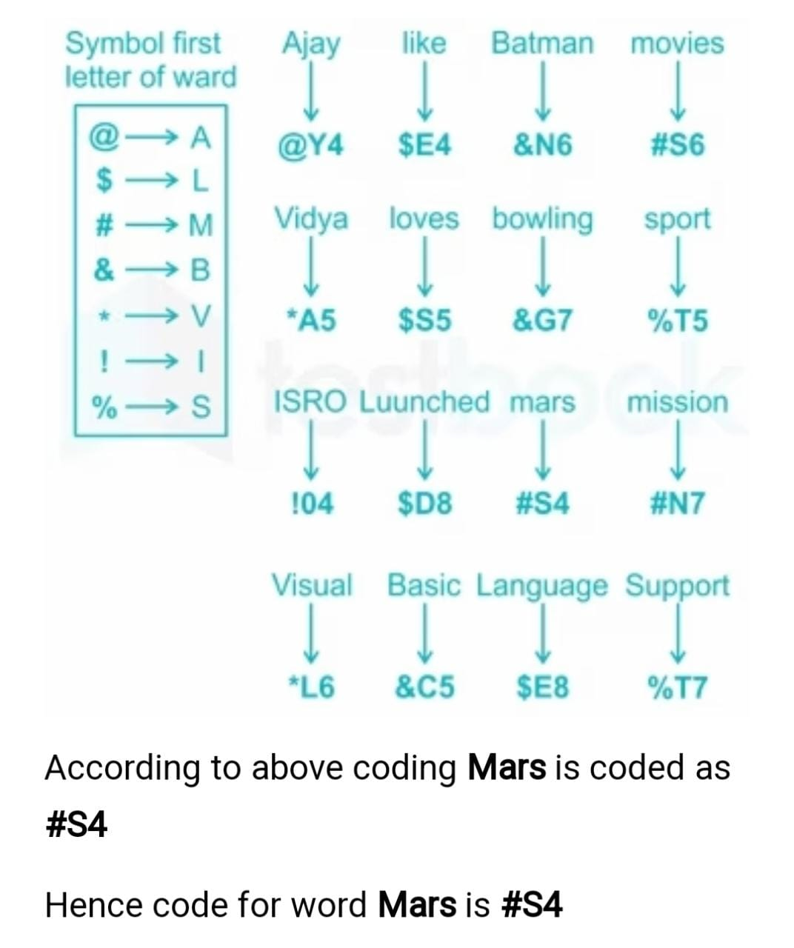
Here in code of word
1) First element is symbol that represent first letter of that word.
2) Middle element is a letter that is last letter of word.
3) Last element of code is number that represent number of letter in last word.
Ex: Ajay will be written as @Y4.
Where @ → represent first letter of word which is A.
Y → represent last letter of word.
4 → represent number of letter in that word.
According to above logic we can code word as represent below.

Slide 27
Thank You

